Slide 1

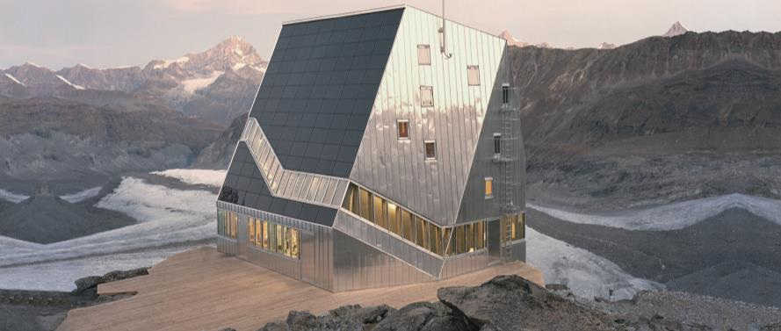
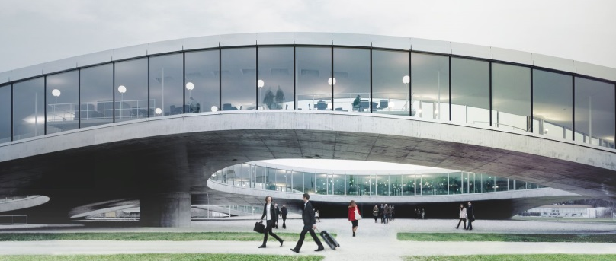
SWITZERLAND FOR FOREIGN INVESTORS
Where tradition meets quality and innovation
HSSR, Swiss-Slovak Chamber of Commerce
Wednesday, 2th of December 2015
Hotel Falkensteiner, SK-Bratislava
Notes:
1

Slide 2
Index
Short Introduction of SwissCEE
Geografical map of Switzerland
10 good reasons to come to Switzerland
High quality FDI support regionally organized
Market entry; Different phases for success
Partners; Must to have and nice to have
Cultural differences taken seriously
Summary: What others say about Switzerland
Notes:
2

Slide 3
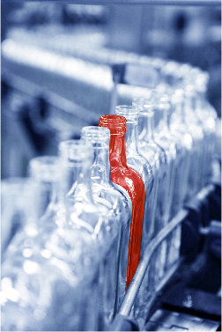
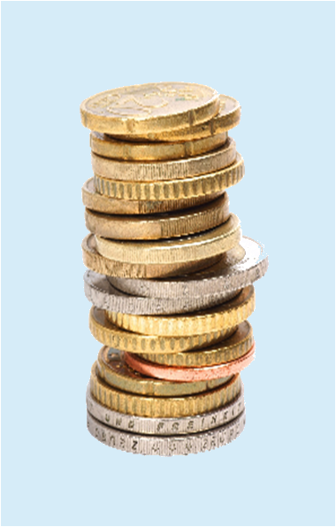
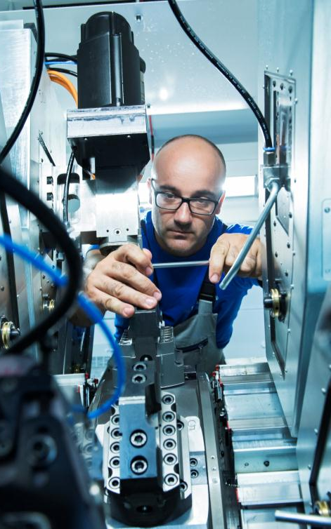

SwissCEE; Offices in CZ-Prague and RO-Bucharest
Business Development | Subsidies A-Z | Contract Manufacturing | Language Services
Notes:
3

Slide 4
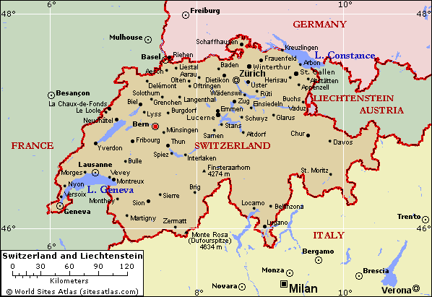
Geografical map of Switzerland with Monte Rosa
Monte Rosa Hut
Inaugurated 09.2009. Project of SAC Swiss Alpine Club to mark 150th anniversary of ETH Zurich. Five-story crystal. Building ist de-signed to obtain 90% of its power from the sun. Water is produced from melting glaciers. Over the next years the hut will become a research station for students from the ETH Zurich. They will use it to inve-stigate how to use energy and resources efficiently.
Notes:
4

Slide 5


10 good reasons to come to Switzerland
Close international integration, reliable relations with Europe
Strategically favorable position
Competitive political and economic framework conditions
Excellent educational Institutions, leading innovation hub
Flexible labor market, high productivity
Efficient capital market, favorable conditions
First-class Infrastructure, high quality of life
World-leading business clusters
Professional support with settling in Switzerland
Attractive taxation
Source: S-GE Switzerland Global Enterprise

Slide 6

High quality FDI support regionally organized
T
A
G
L
U
U
R
O
W
N
W
I
Source: S-GE Switzerland Global Enterprise
Notes:
6

Slide 7
Professional support on four levels
Federal: S-GE
Image, Basic Information, Prospect Generation
Regional: GZA, GGBA, BaselArea, SGBA
Image, Lead Generation
Cantonal: 26 Economic Promotion
Lead Generation, Detailed Offers, Settlements
Municipal: Local Promotion
Land/Property, Settlements
Source: S-GE Switzerland Global Enterprise
Notes:
Switzerland
Basically, we operate on 4 levels…
The task of the federal level is to promote Switzerland as a business location in various countries around the world…
This includes Basic Information, seminars and marketing campaigns to further strengthen the image of our country…
The representatives of the 5 Regions of Switzerland promote their area and additionally they consult companies…
Whereas the representatives of the Cantonal Economic Promotion Agencies establish detailed offers for settlements…
And by doing so, they are often supported by Municipal bodies, e.g. when searching for the best real estate location…

Slide 8
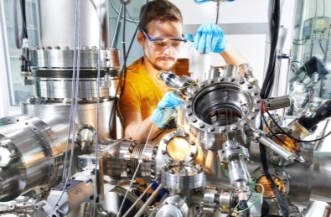
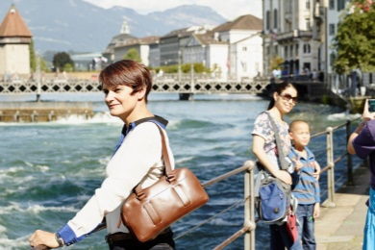
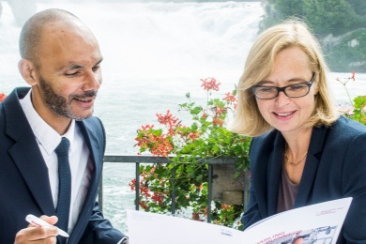
Market entry project; Different phases for success
Image
Targets
Innovation and Technology
Security and Confidence
Environment and
Life
Contacts
Prospects
Support regionally
organized
Consultant / Areas / Cantons Partner
S
H
B
S
B
L
T
G
Lead
A
G
Z
H
A
J
U
S
O
Z
G
A
R
I
N
E
L
U
S
Z
G
S
G
B
E
O
W
N
W
U
R
L
V
D
F
R
G
R
Setup
T
G
E
V
S
I

Slide 9

Partners: Must to have and nice to have
  Must to have:
    Entrepreneur, Distributor
    Notary
    Administrator
  Nice to have:
    Economic promotion agencies as S-GE
    Consultants (for example as prime contractor)
    - Lawyer
    Real estate and/or HR agency
© SwissCEE, 02.12.2015, HSSR Bratislava
Notes:
9

Slide 10

Cultural differences taken seriously
  Leadership style:
    Team player versus Patriarchy
    Process orientation rather than People
    Compliance with milestones
  Cultural differences:
    Different time understanding
    Functionality comes before aesthetics. Swiss doesn’t accept
    compromises on the high quality standards
    Error culture
© SwissCEE, 02.12.2015, HSSR Bratislava
Notes:
10

Slide 11
Summary; What others say about Switzerland
There’s no compromising when it comes to quality. If we want to offer our customers products aligned to their needs, we must be innovative.
HESS Medizintechnik AG
Thanks to trusting partnership relationships, Bayer has been operating successfully in Switzerland since 1954. Bayer Pharma Switzerland
Switzerland is a key location for research into and development of Google products. This is where the inventive spirit lives.
Google Switzerland GmbH
Switzerland’s diversity provides an environment where creative minds can develop brilliant ideas.
Microsoft Switzerland GmbH
Being innovative means developing products and services in close collabo-ration with the customer.
Schurter AG, Electronic Components
With its strong educational and research base, the ETH, Federal Institute of Technology Zurich, produces a wealth of innovations. President ETH Zurich
© SwissCEE, 02.12.2015, HSSR Bratislava
Notes:
11

Slide 12
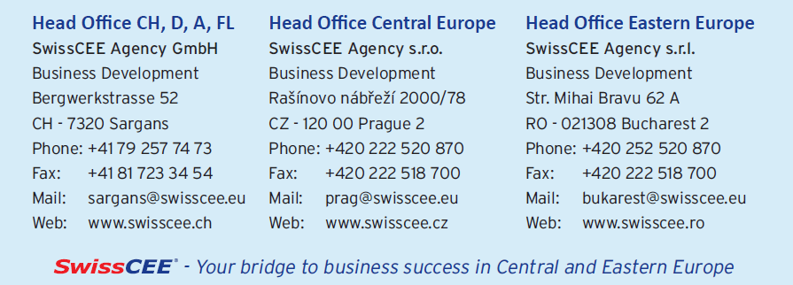
How we can help you?
Thank you for your attention
Notes:
12

